Slide 1
Folio
An inventory management app for bookshops

Slide 2
Design Brief
Build an app which allows a shopkeeper to track their shop's inventory. This is not an app which the customer will see, it is an admin/management app for the shop workers.
The inventory should track individual products, including a name, description, stock quantity, buying cost, and selling price.
The inventory should track manufacturers, including a name and any other appropriate details.
The shop can sell anything you like, but you should be able to create, edit and delete manufacturers and products separately.
Show an inventory page, listing all the details for all the products in stock in a single view.
As well as showing stock quantity as a number, the app should visually highlight "low stock" and "out of stock" items to the user.

Slide 3

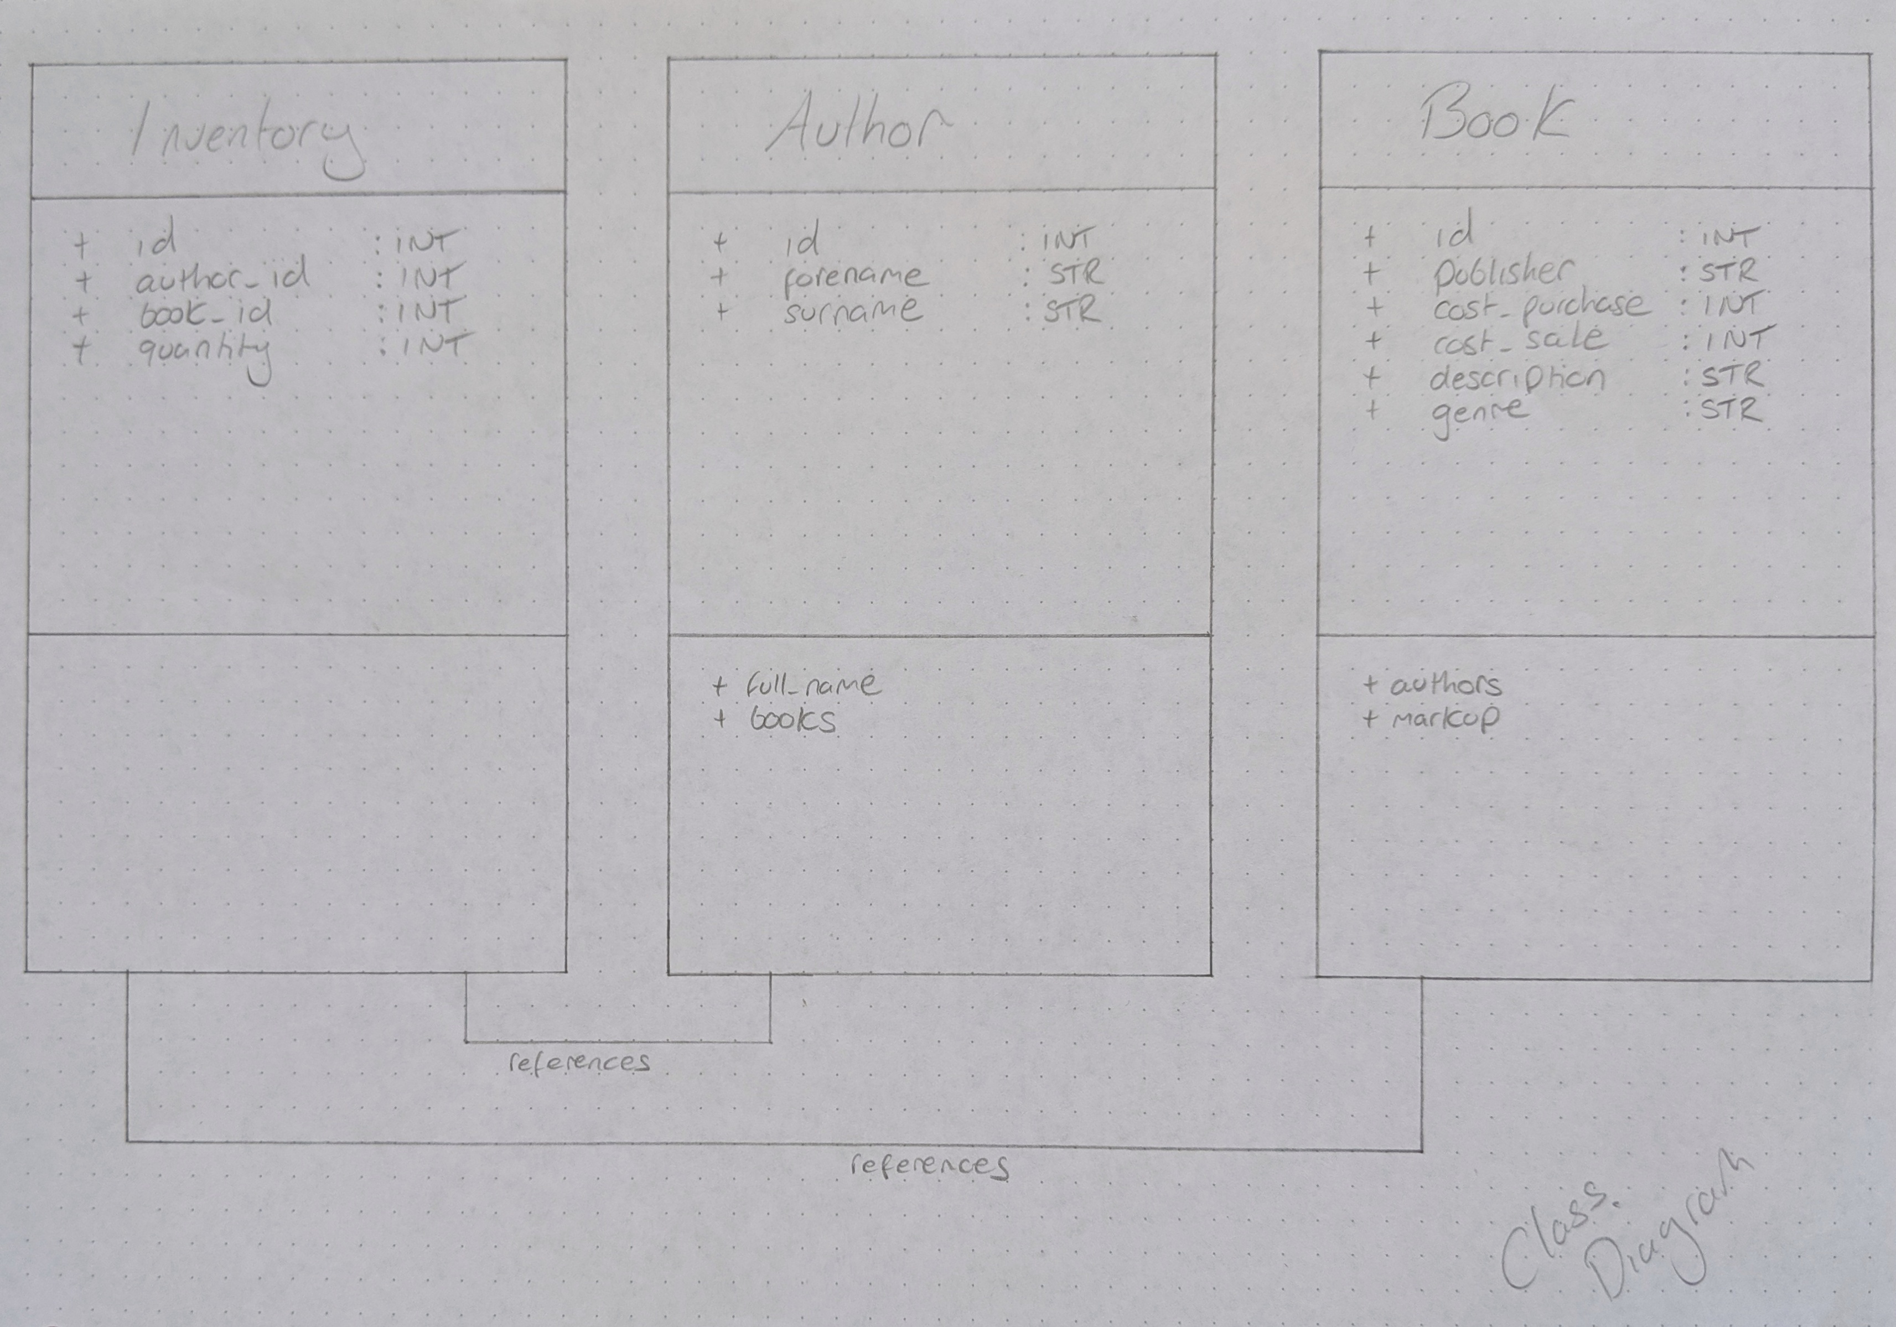
Planning
3 Classes
Many to Many
Author - Inventory – Book
Inventory was to act as the junction table, which would prove problematic later
SQL was a direct mirror of the above

Slide 4

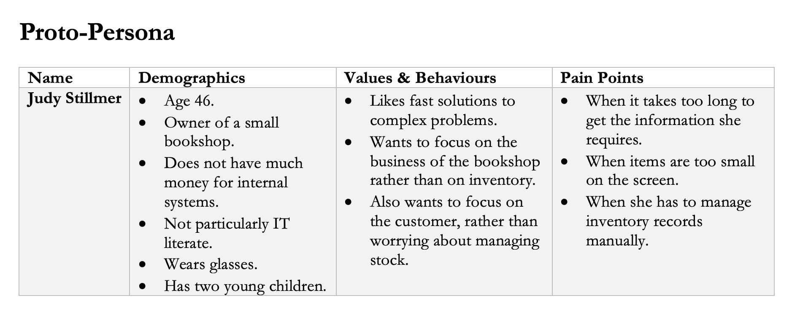



Proto-Persona

Slide 5
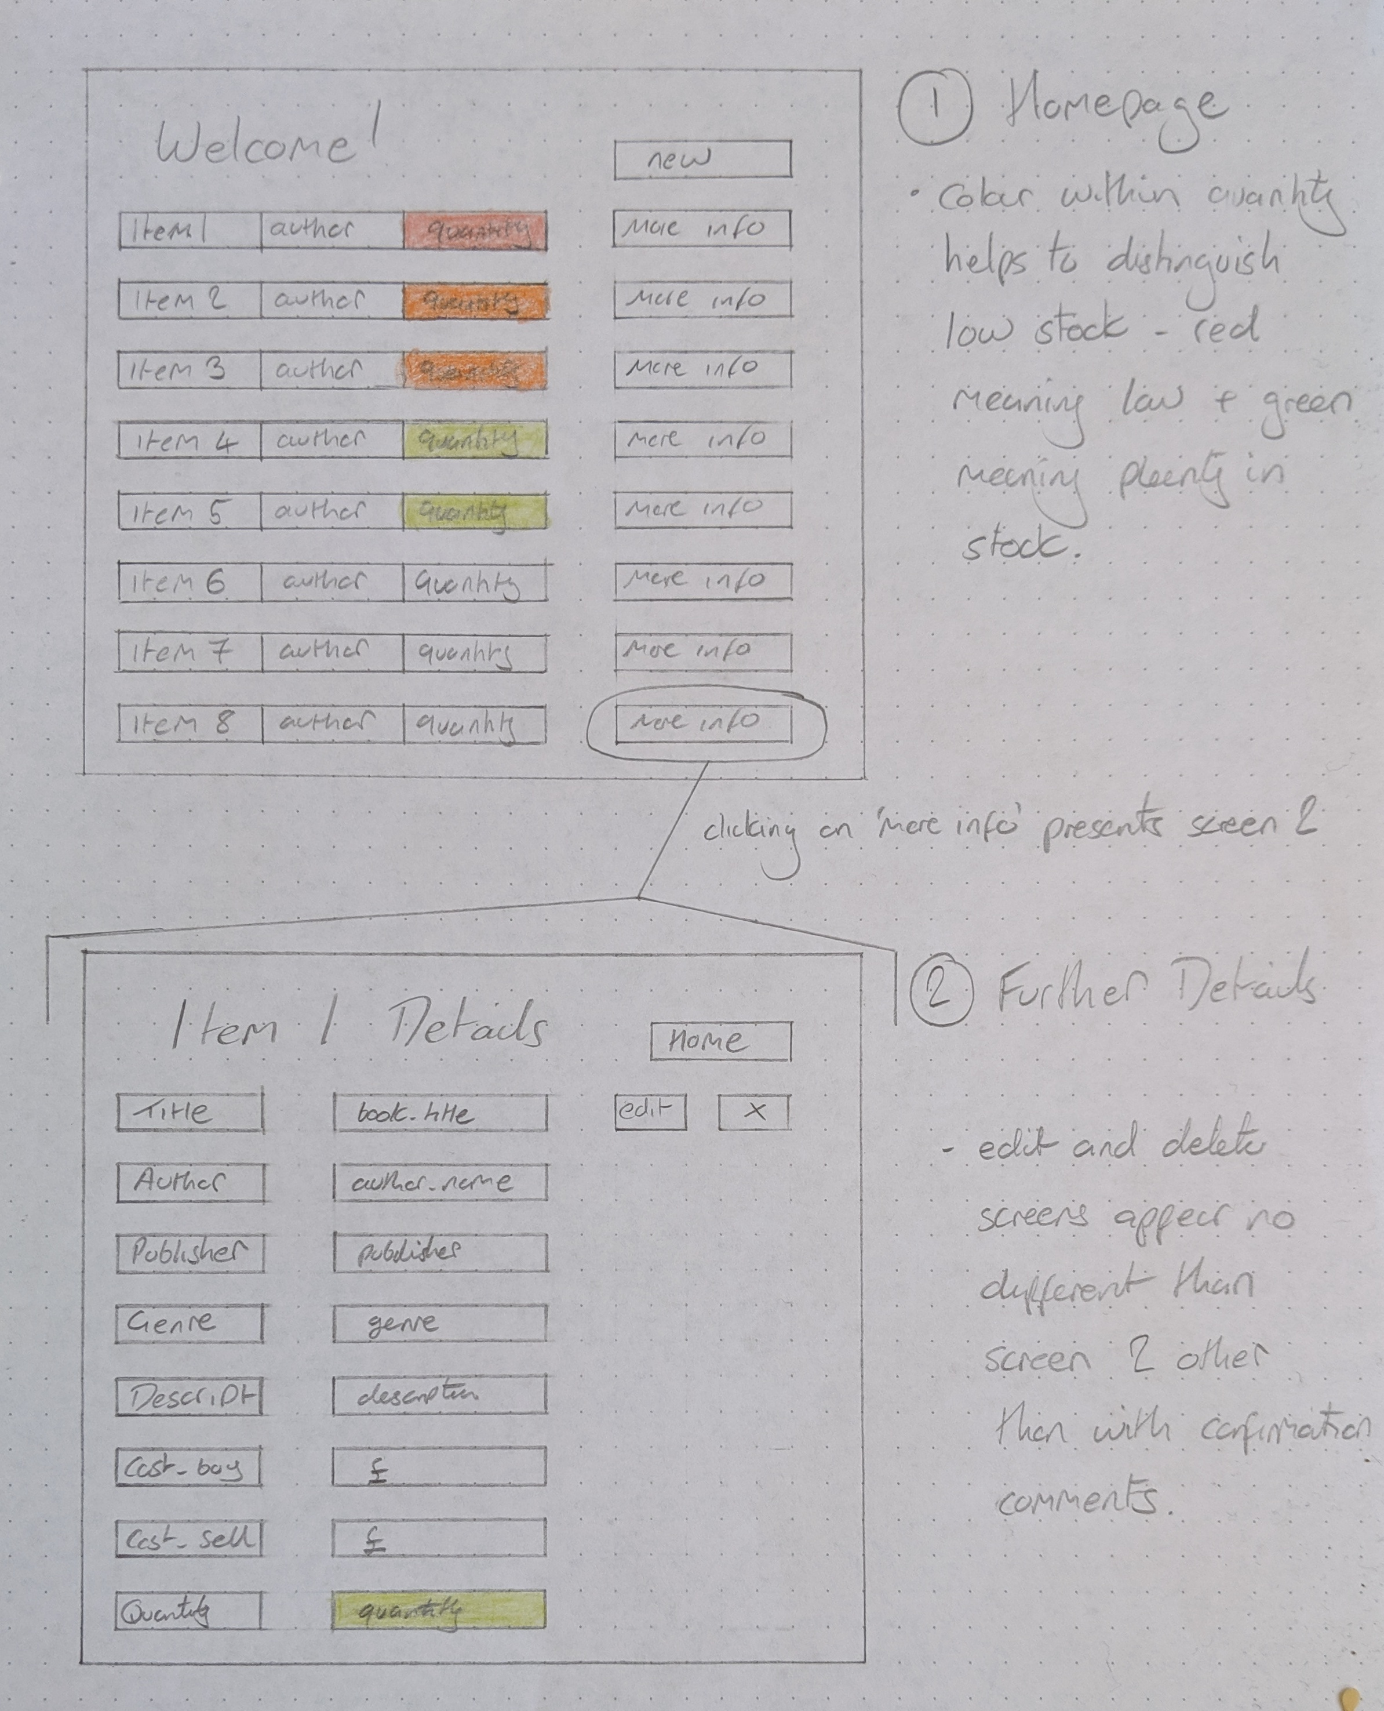
Wireframes
Two screens imagined initially, with all functions accessible from these screens
Functions to edit and delete records were to be accessible behind the second screen, so as to avoid accidental deletion
Big blocky buttons for ease of use

Slide 6
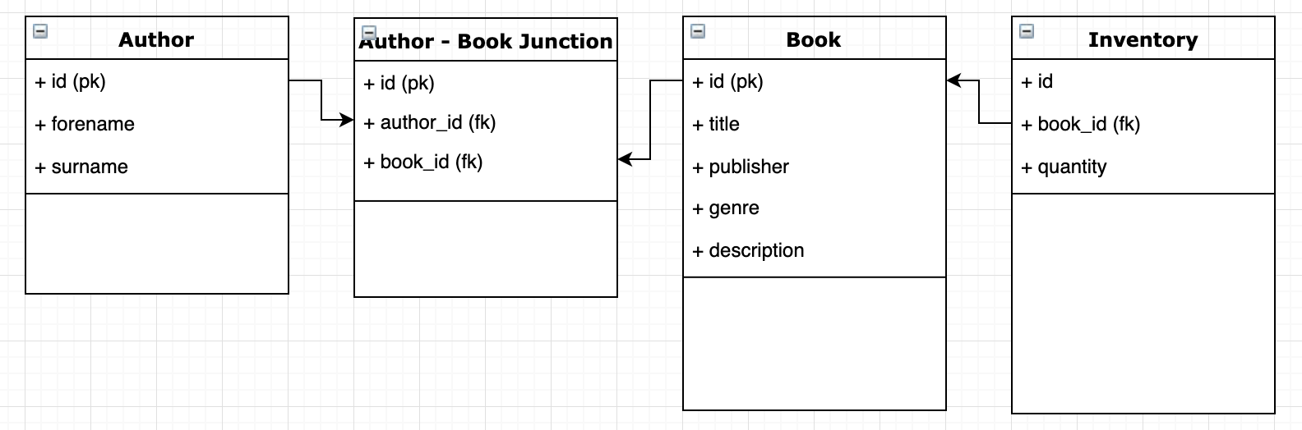
Main Learning Points
Database construction requires forward thinking
Any changes require significant alterations
Location of methods requires further thought when new tables and classes are introduced

Slide 7
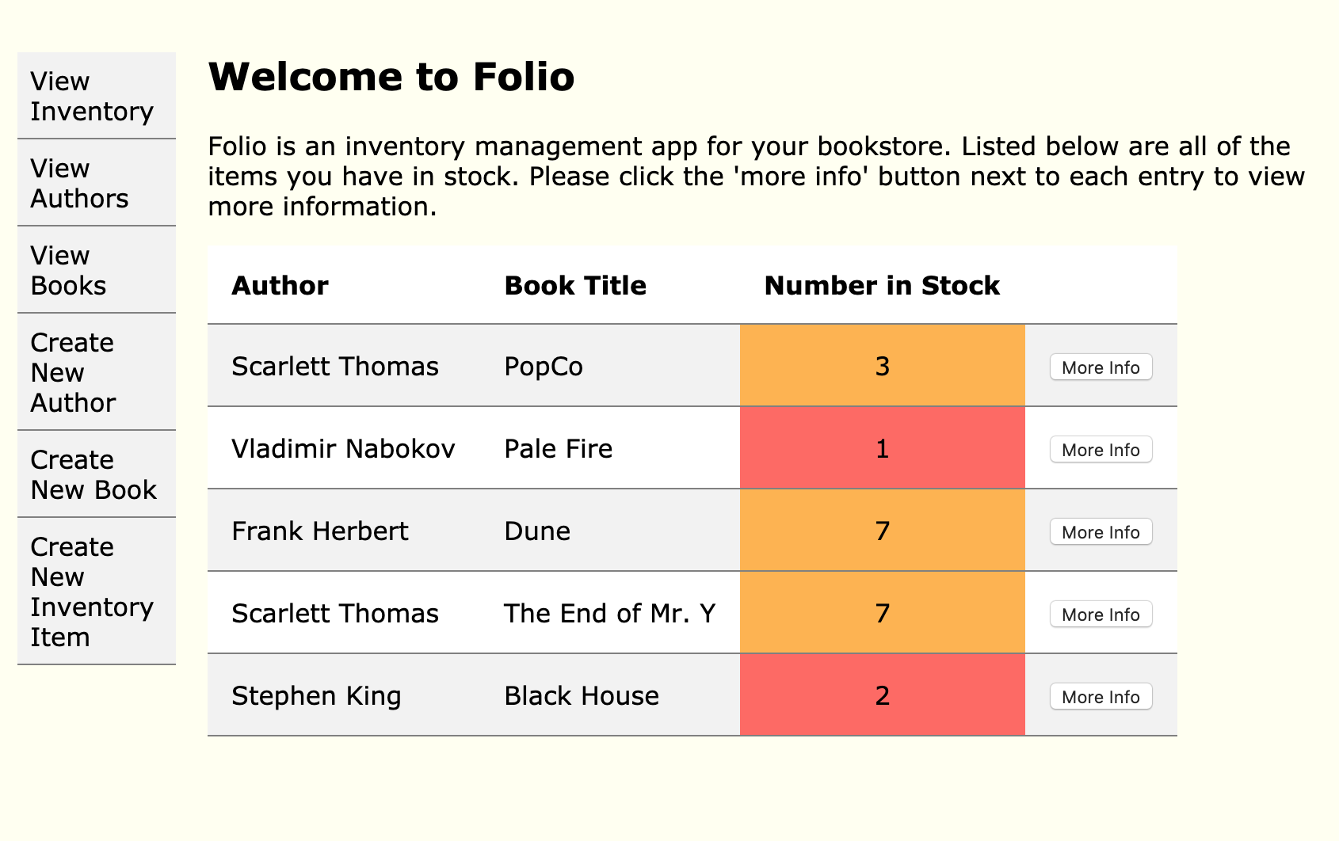
To the App!

Slide 8
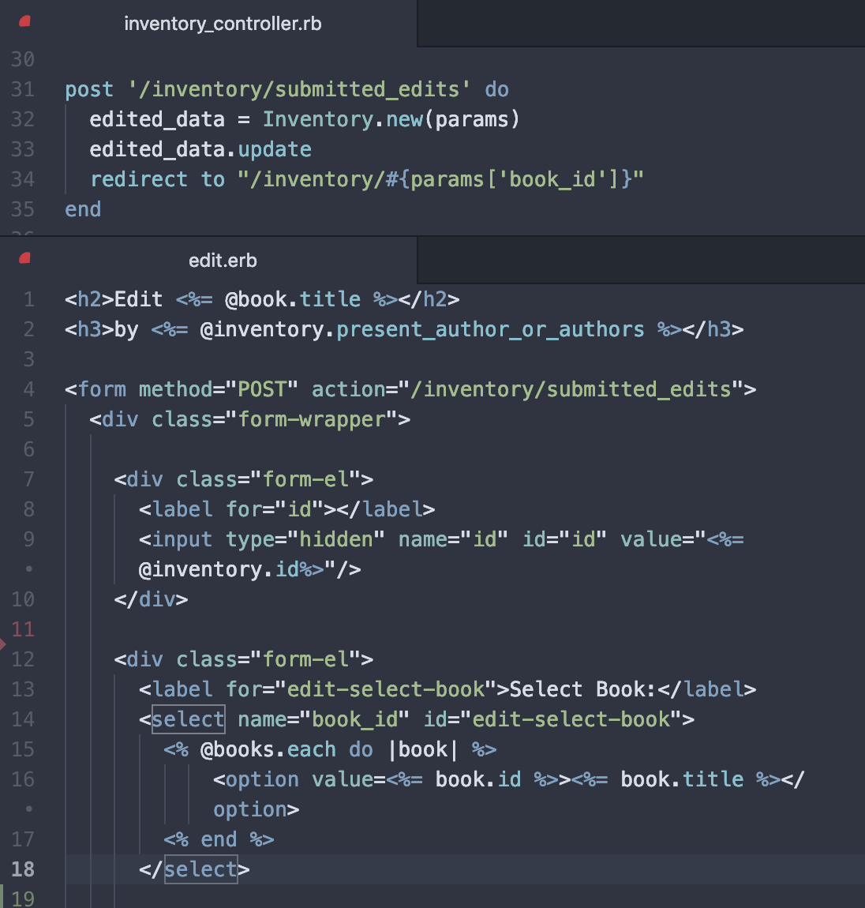
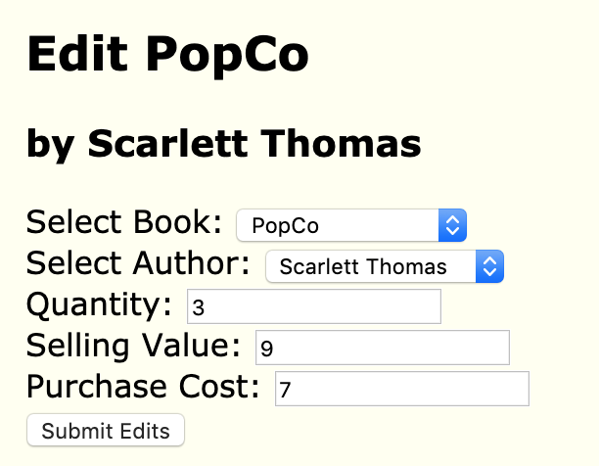
Pride Points

Slide 9
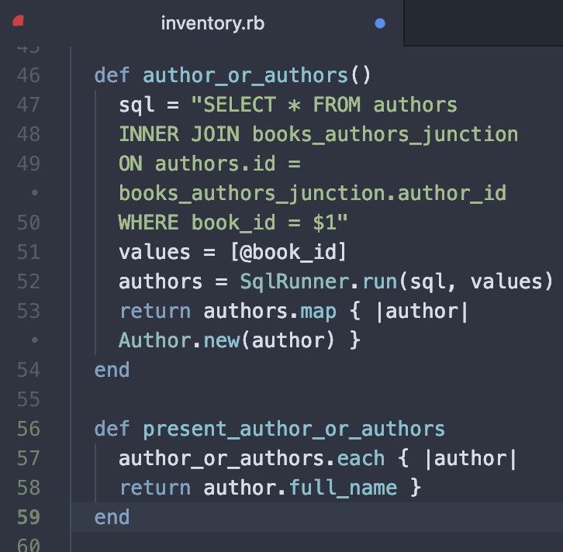
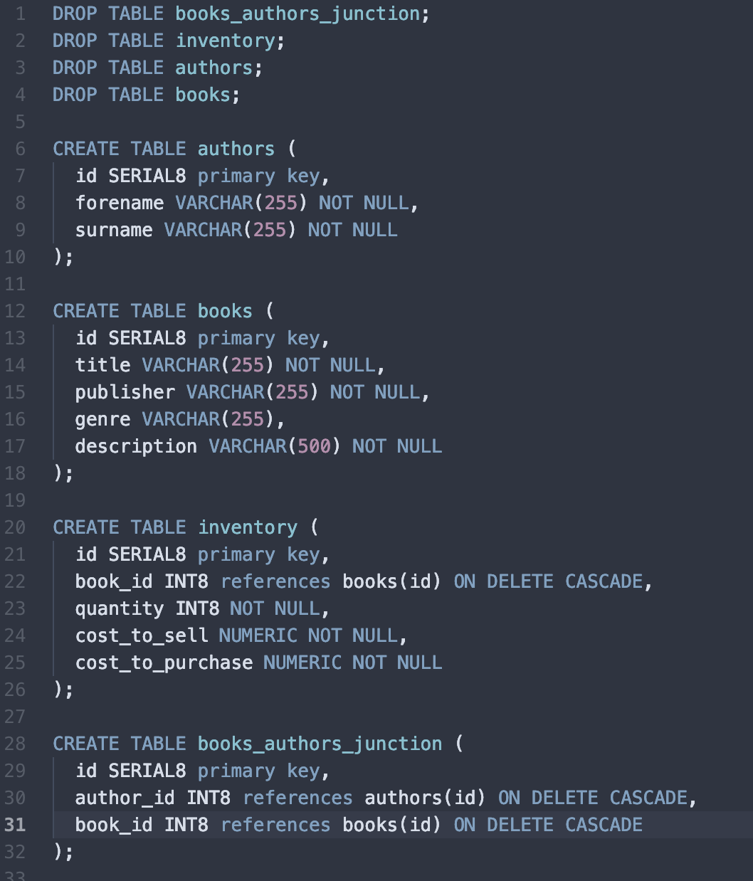
Continued

Slide 10
What Would Improve Folio?
Styling on form fields to make them more user friendly
Larger buttons to make more user friendly
Creation ‘wizard’ to help in the creation of inventory items
The ability to allow for further details to be added and shown in Author and Book views

